Slide 1
Azure Kubernetes Service Containers Overview
Tim Oleson

Slide 2

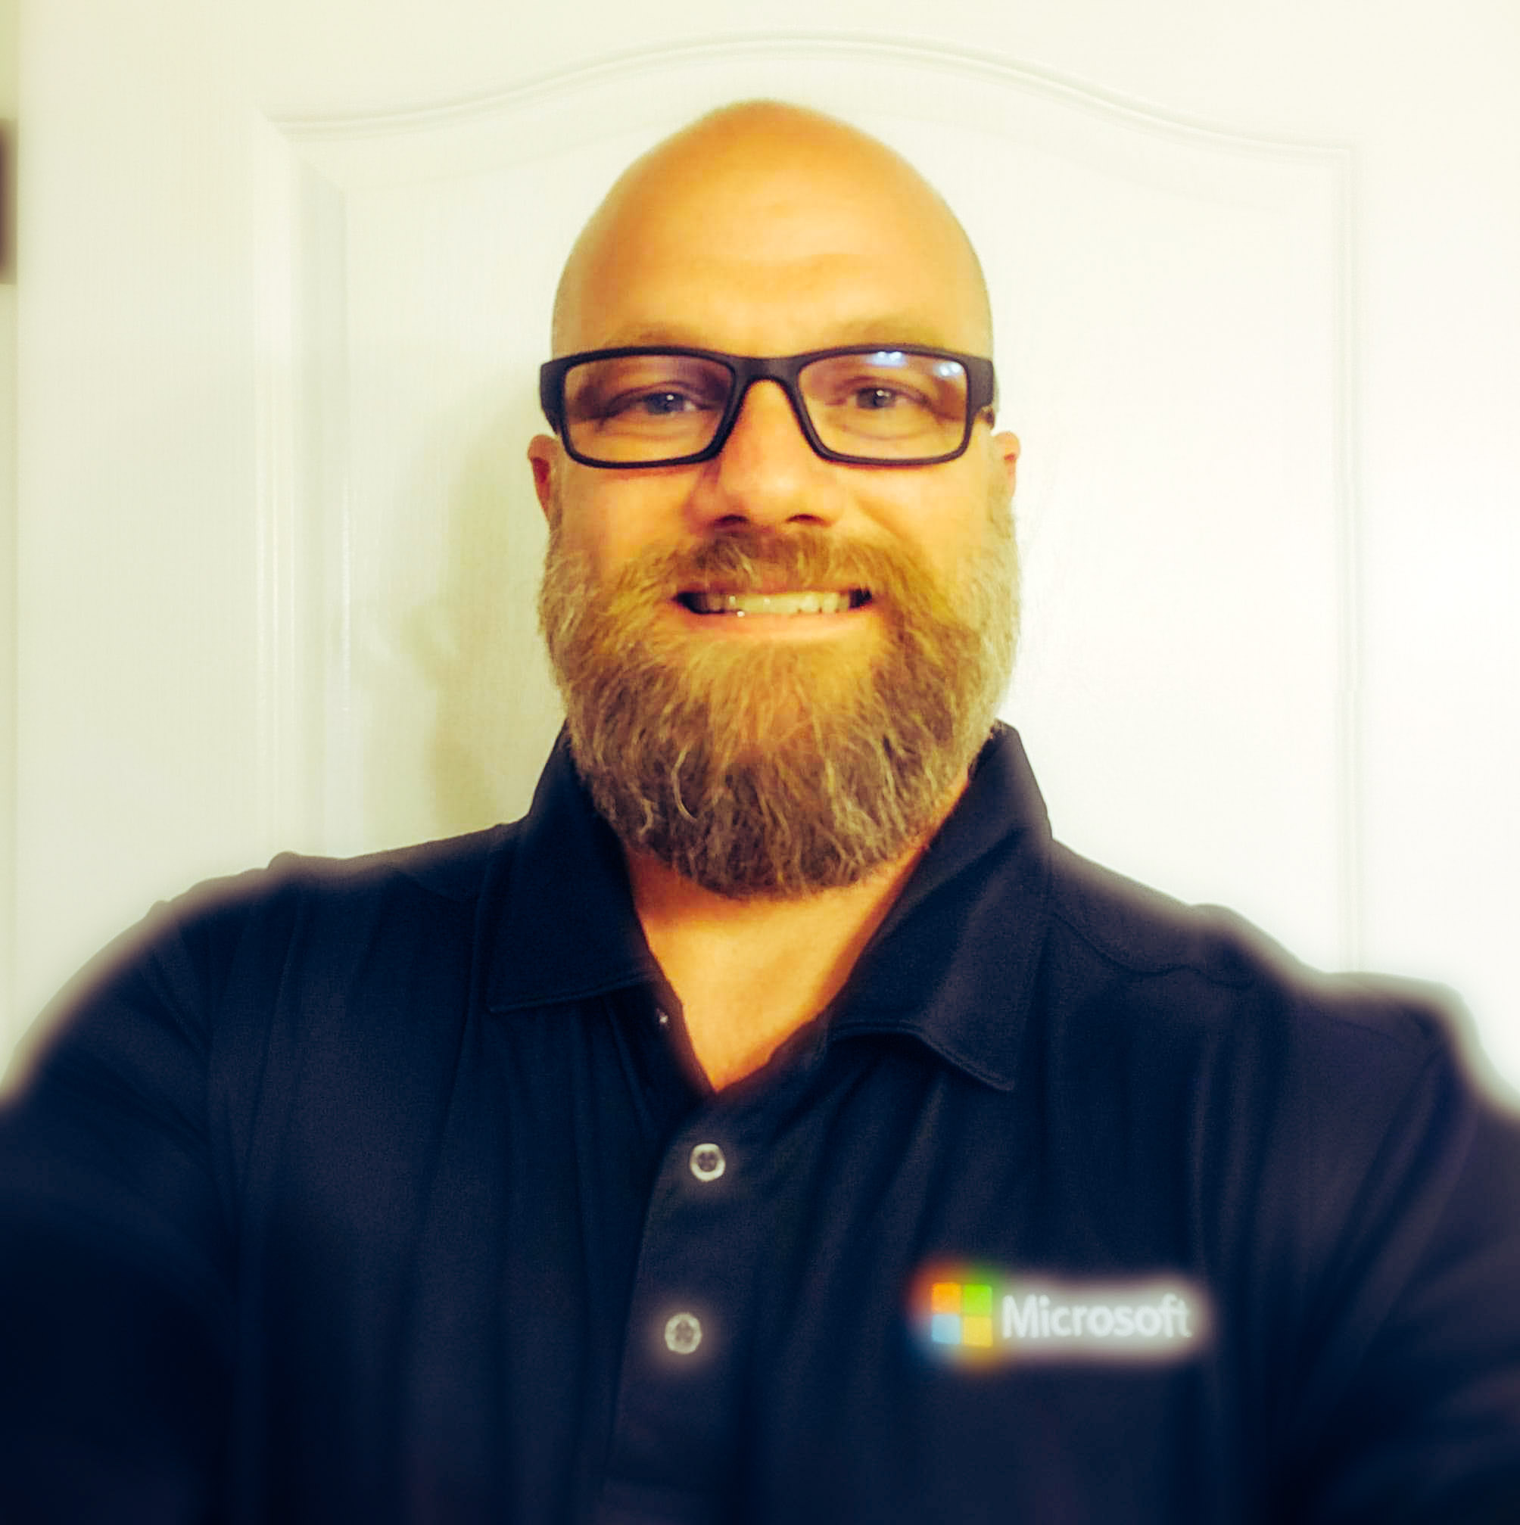




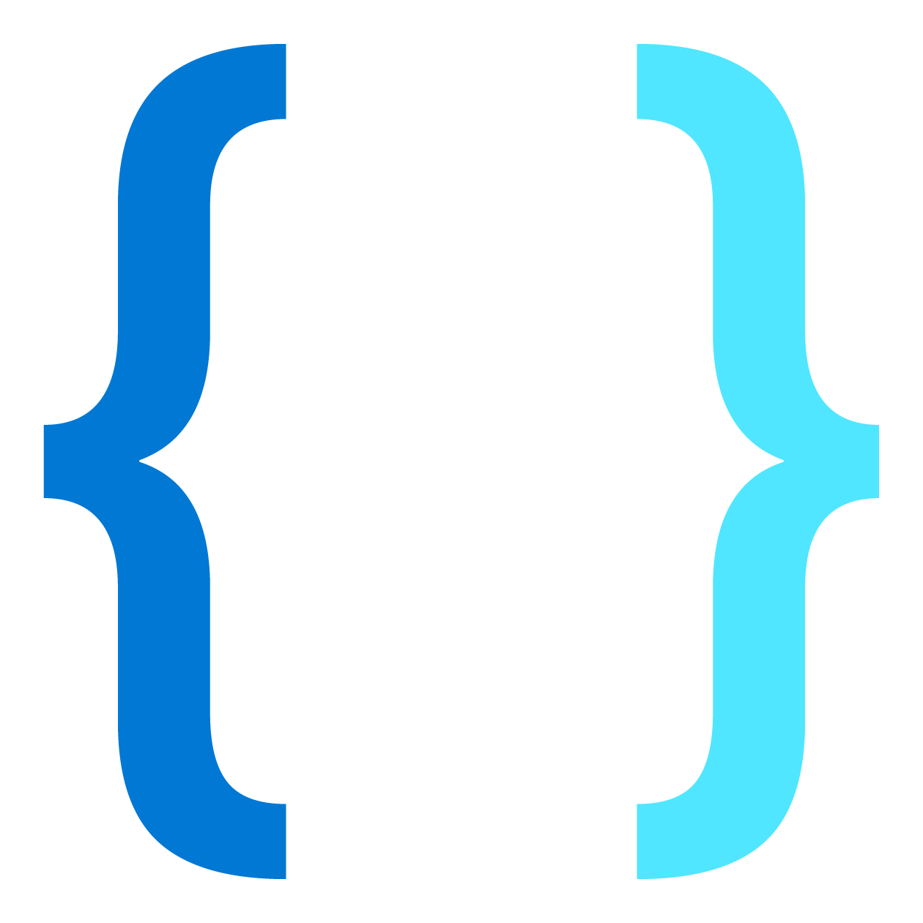
Tim Oleson
Customer Engineer
U.S. Army Retired SFC 24 yrs
Software Engineer 17 yrs
Web Developer 20 yrs
Aspiring Architect
Family: Marcela Oleson, Brandy(27), Tomas(17), Anna(7)
Passions: Domain Driven Design, Web Development, Object Oriented Design, SOLID Design Principles, Architecture,
Art, Photography, Digital Illustration, Bass Fishing and Break Dancing.
Tech: Azure PaaS, Cosmos DB(Data Modeling, Gremlin Api(graphDb)) , SQL Developer(Store Procedures, Functions) Azure Monitor(Application Insights), Asp.Net, .Net Core, .NodeJS, Angular, gRPC, Dockers, Azure Kubernetes Services, Http Restful Web APIs, Azure Service Bus(Message Broker, EventHub), Splunk Integration
Patterns: MVC, Factory, Microservices, Domain, Transact Script, Table Module
Languages and Scripting: C#, JavaScript, TypeScript, SQL, Linq, and learning C
Agile Methods: DevOps, Agile Scrum, Agile Scale, Spec Flow, Unit Testing, Behavioral Driven Design, Git(Distributed Version Control), Team Foundation Version Control (TFVC) (Centralized Version Control)
Heroes: Ragnar Lodbrok, Batman, Martin Fowler, Uncle Bob, Eric Evans, The Gang of Four

Slide 3
Containers
Tim Oleson

Slide 4
Agenda
What is Docker?
Introduction to Docker Containers
Creating Containers
Docker Layers
Building Custom Images

Slide 5
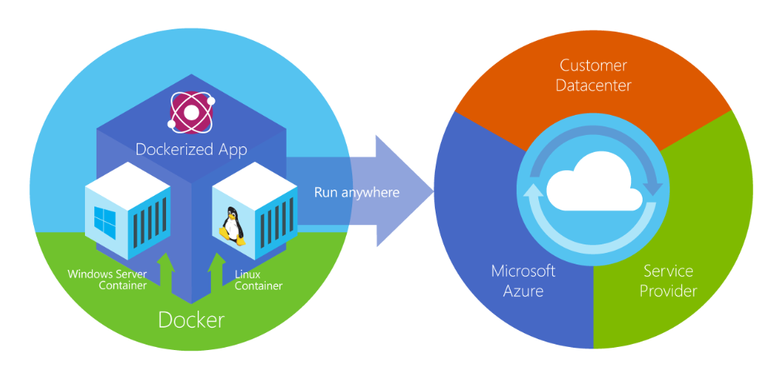
What is Docker?
open-source project for automating the deployment of applications as portable, self-sufficient containers
run on the cloud or on-premises.

Slide 6
Docker Vocabulary
Host A VM running the Docker Daemon to host a collection of Docker Containers
Client Where docker commands are executed (client/server)
Image An ordered collection of filesystems (layers) to be used when instancing a container (more on it later)
Container A runtime instance of an image
Registry A collection of docker images

Slide 7
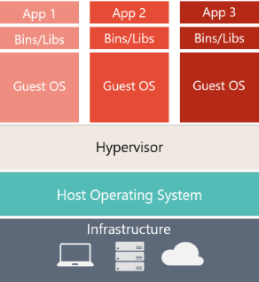
Challenges with Virtualization
OS != Business value
Scripts to Create VMs Hard to manage
Lead to VM Immutable Infrastructure
VM Image
VM Images are Heavy (100mb)

Slide 8
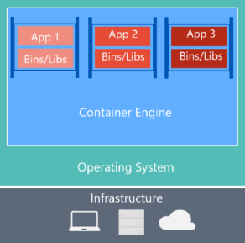
Virtual Machine versus Containers
Containers lightweight small in size (20 mb)
Separated the App from the Operating System

Slide 9




Container
Unit of Deployment
Simplified testing
Unit of versioning
Distributed Applications
Repo/Registry
App

Slide 10
Containers
Traditional
Modern
Applications traditionally built and deployed onto physical systems with 1:1 relationship
New applications often required new physical systems for isolation of resources
Package and run apps within
Physical
Containers
Higher consolidation ratios and better utilization
Faster app deployment than in a traditional, physical environment
Apps deployed into VMs with high compatibility success
Apps benefited from key VM features i.e. Live migration, HA
Physical/Virtual
Key Benefits
Further accelerate of app deployment
Reduce effort to deploy apps
Streamline development and testing
Lower costs associated with app deployment
Increase server consolidation
Virtual

Slide 11
Docker
Tim Oleson

Slide 12
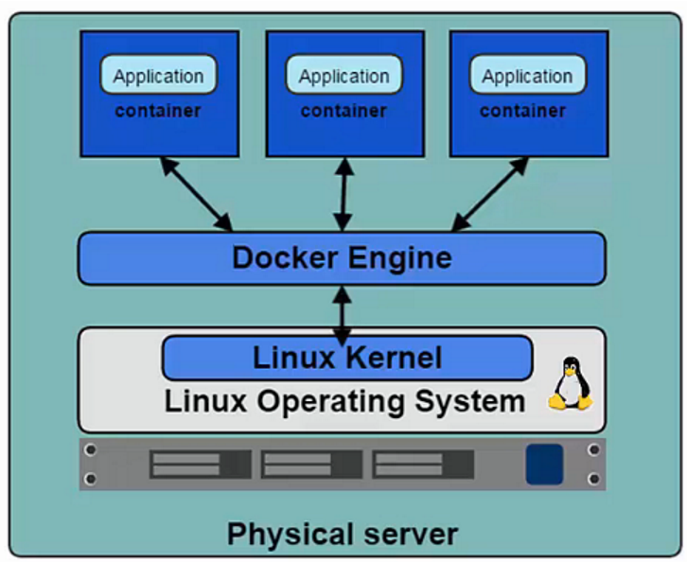
Docker Platform
Docker Engine (a.k.a. Docker Daemon)
The program that enables containers to be built, shipped, and run.
Uses Linux Kernel namespaces and control groups to give an isolated runtime environment for each application

Slide 13
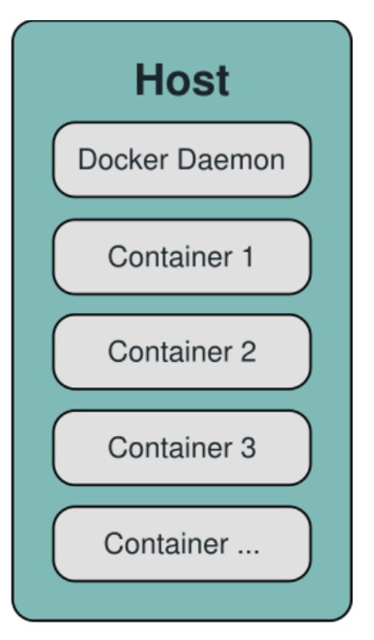
Docker Platform
Takes user inputs and sends them to the Daemon.
Client and Daemon can run on the same host or on different hosts.
Docker Client
docker pull
docker run
docker build

Slide 14
Docker Platform
Docker Images
Read-only template used to create containers.
Contains a set of instructions for creating the containers.
Docker builds images automatically by reading the instructions from a Dockerfile:
Each instruction creates one layer:
FROM creates a layer from the ubuntu:18.04 Docker image.
COPY adds files from your Docker client’s current directory.
RUN builds your application with make.
CMD specifies what command to run within the container.
FROM ubuntu:18.04
COPY . /app
RUN make /app
CMD python /app/app.py

Slide 15
Docker Platform
Docker Containers
Isolated application platform based on one or more images.
Contains everything needed to run your application
Once you have the dockerFile you can use the command: docker build .
Docker Client
docker build .

Slide 16
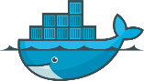








Docker In Action
Client
DOCKER_HOST
Registry
Docker pull
Docker daemon
Docker run
Containers
Images Cache
WordPress
WordPress

Slide 17
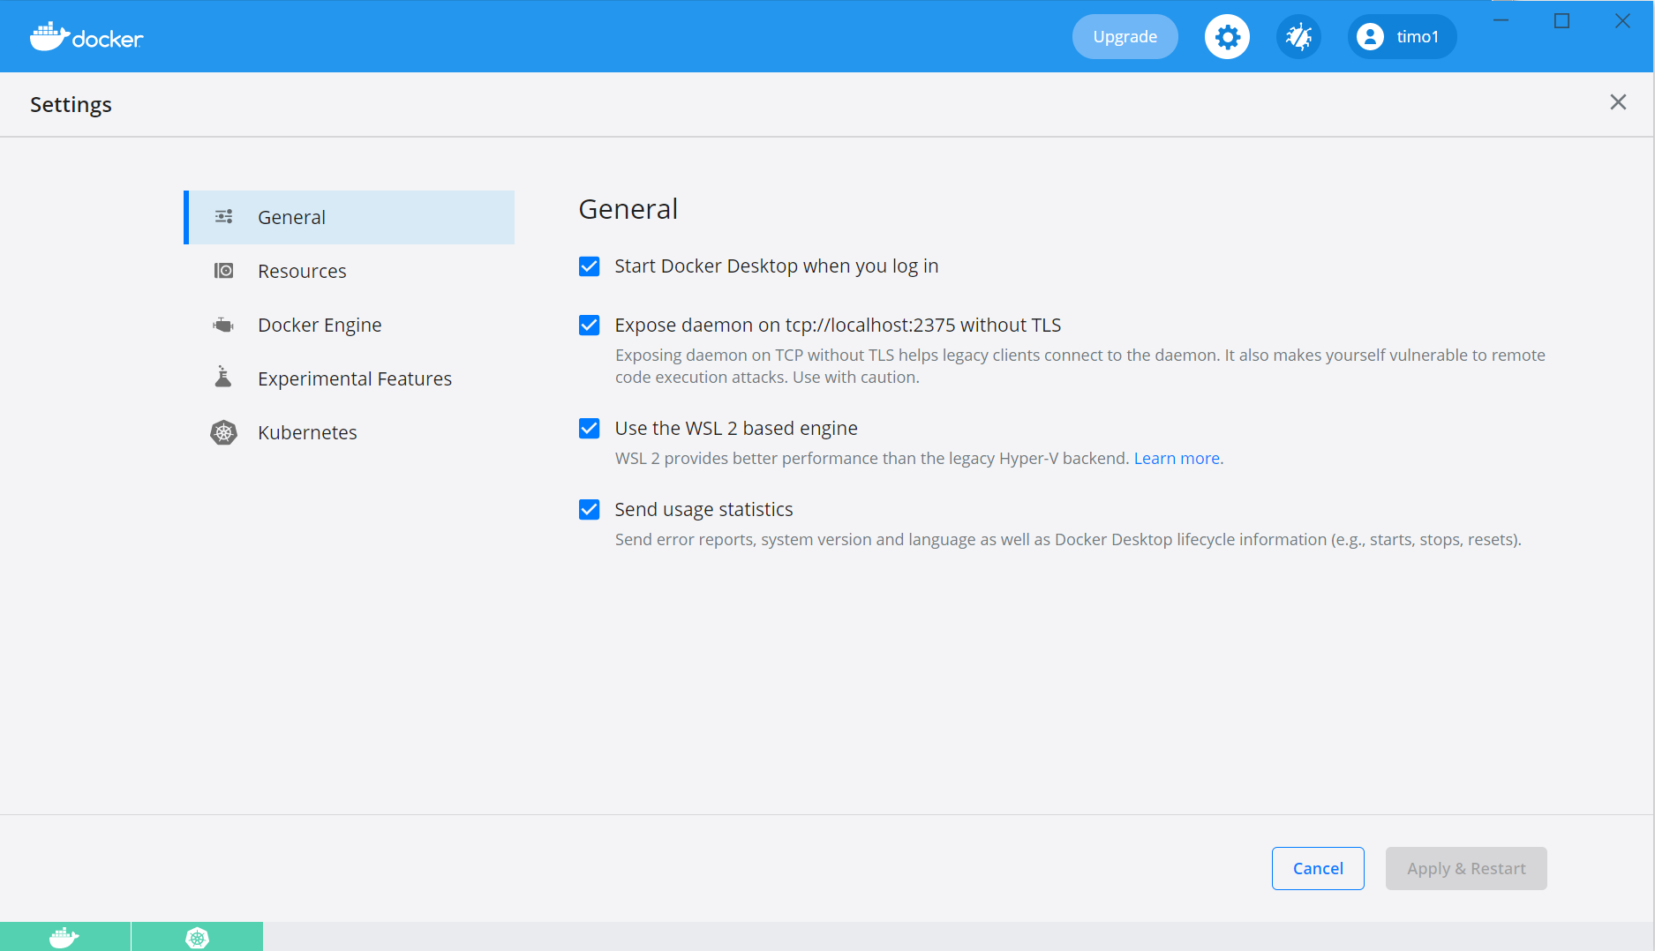
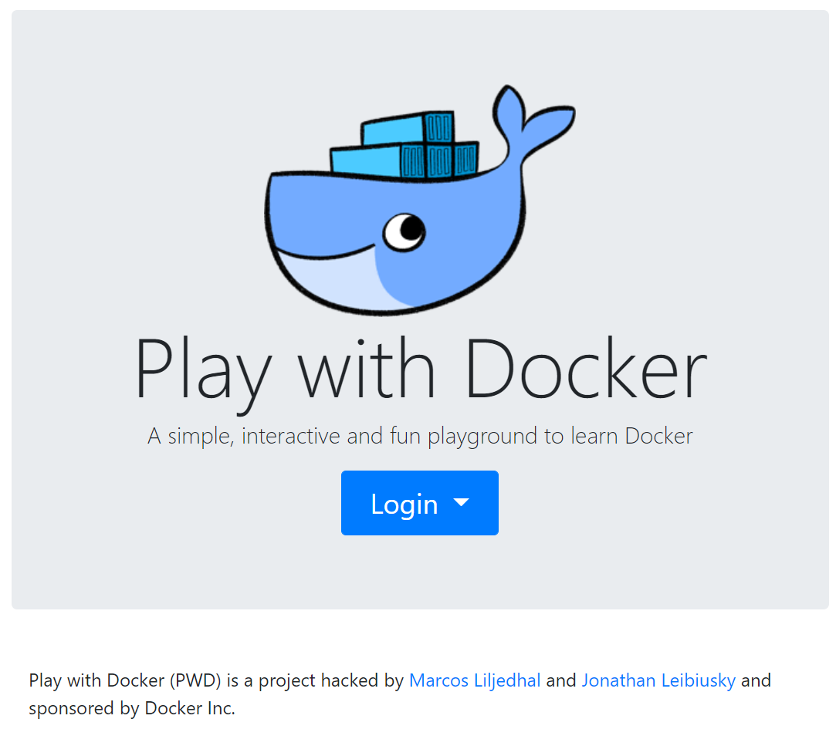
Docker Desktop & Playground
Docker Desktop
Docker Desktop is an easy-to-install
Mac or Windows environment
Build and share containerized applications and microservices.
Includes Docker Engine, Docker CLI client, Docker Compose, Notary, Kubernetes, and Credential
Docker Playground no install learn fast and easy
Timed instance
Work is not saved
https://labs.play-with-docker.com/
Need a Docker Account setup

Slide 18
Docker-Compose
Define and run multi-container Application
Good for local development, testing environments
Three Step Process
Define your app’s environment with a Dockerfile so it can reproduce anywhere.
Define the services that make up your app in docker-compose.yaml so they can run together in isolated environment.
Run docker-compose up and Compose starts and runs your entire app.

Slide 19
Demo Compose an Image and Run your image
Tim Oleson
Notes:
https://docs.microsoft.com/en-us/azure/aks/tutorial-kubernetes-prepare-app
Make Directory
Md DockerDemo\ExampleCode\
Cd DockerDemo\ExampleCode\
Git Code
git clone https://github.com/Azure-Samples/azure-voting-app-redis.git
Navigate to
cd c:\DockerDemo\ExampleCode\azure-voting-app-redis
c:\DockerDemo\ExampleCode\azure-voting-app-redis>
Run Docker Compose to build images and run the container
c:\DockerDemo\ExampleCode\azure-voting-app-redis>docker-compose up –d
Commands Explained
(-d, --detach Detached mode: Run containers in the background)
List Images (local)
docker images
Show running Containers Open another command prompt
docker ps -l
Stop
docker-compose down
To see the running application, enter http://localhost:8080 in a local web browser.

Slide 20
Docker Registry
Tim Oleson

Slide 21
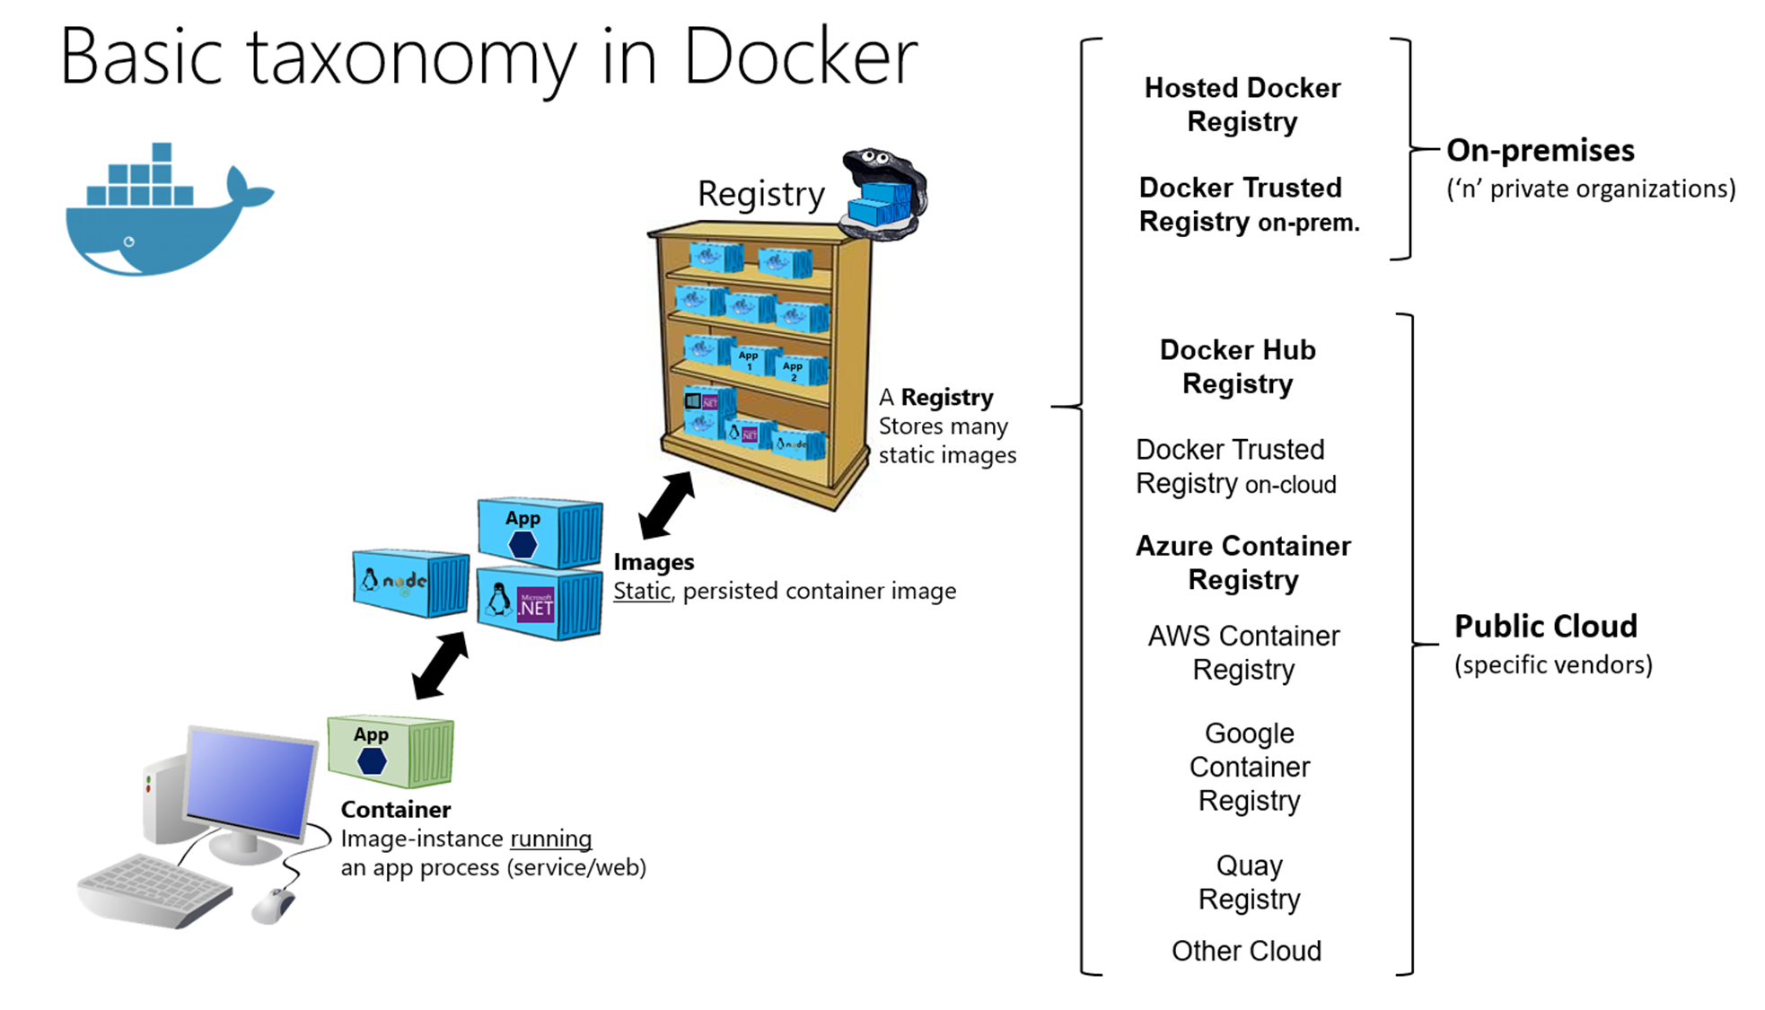
Docker Platform
Docker Hub
A online registry of Docker images
Docker Trusted Registry
Private on-site Registry for Docker images
Azure Container Registry

Slide 22
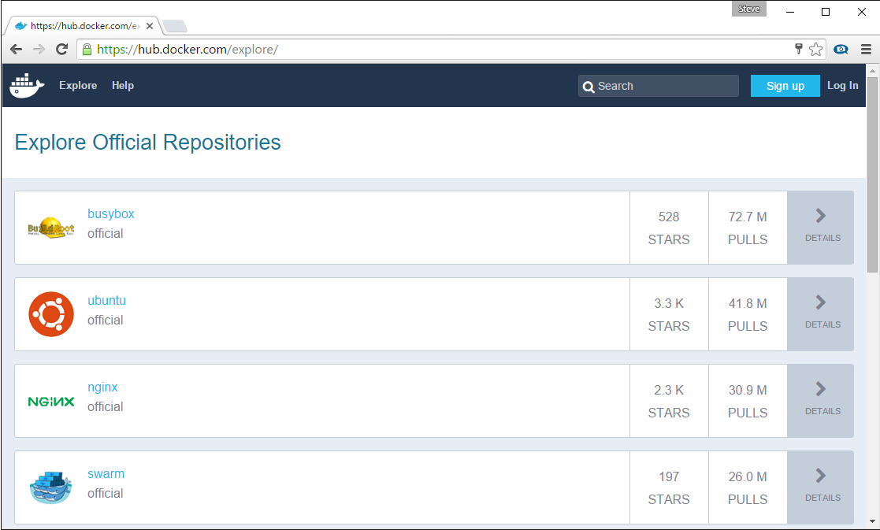
Docker Registry
Stores docker images
Searchable
Public Registry – hub.docker.com
Private Registries – Instanced for you. E.g. Azure Container Registry
The Registry is open-source under the permissive Apache License
Get image of Azure Registry

Slide 23
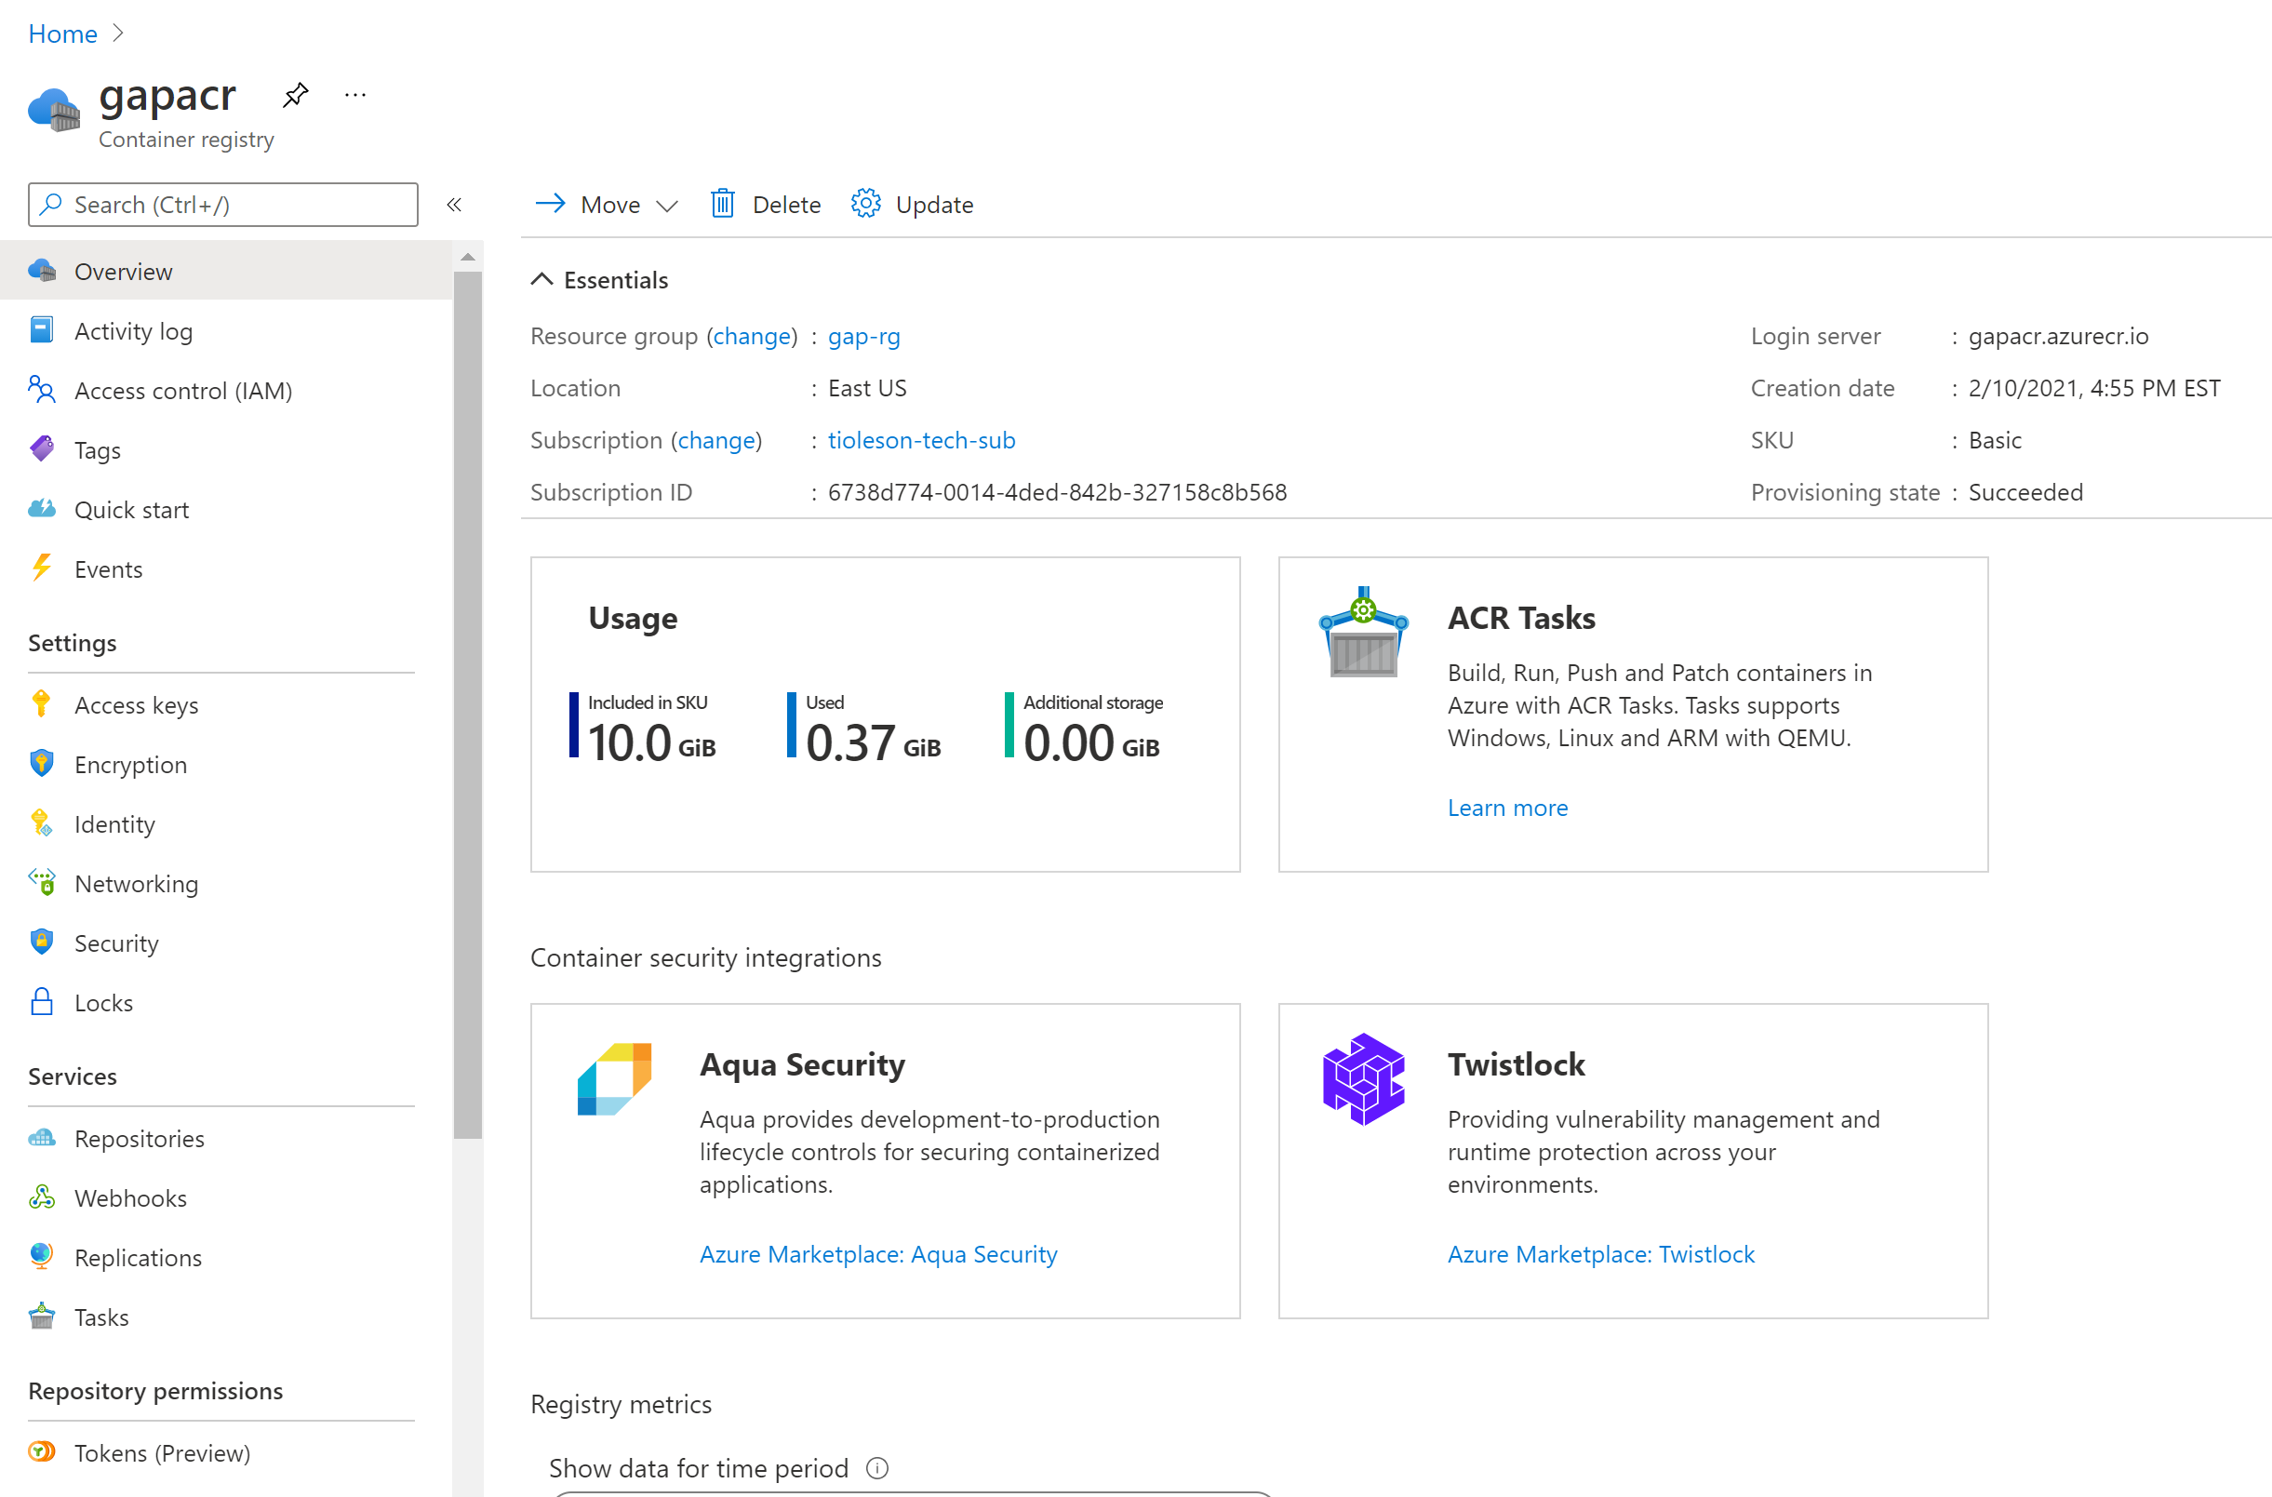
Azure Container Registry
Azure Container Registry is a managed Docker container registry service used for storing private Docker container images

Slide 24

Demo Docker Registry
Tim Oleson
Notes:
https://docs.microsoft.com/en-us/azure/aks/tutorial-kubernetes-prepare-acr
Create Resource Group
az group create --name gap-rg --location eastus
Create ACR
az acr create --resource-group gap-rg --name gapacr1a --sku Basic
Login To ACR
az acr login --name gapdemoacr
Tag Image local copy
docker tag mcr.microsoft.com/azuredocs/azure-vote-front:v1 gapacr.azurecr.io/azure-vote-front:v1 (change v1 to v2)
Push Image to ACR
Get list of ACR login servers
az acr list --resource-group gap-rg --query "[].{acrLoginServer:loginServer}" --output table
Output
gapacr.azurecr.io
Push Image to registry
docker push gapacr.azurecr.io/azure-vote-front:v1
Tag Image
docker tag mcr.microsoft.com/azuredocs/azure-vote-front:v1 timoacr.azurecr.io/azure-vote-front:v1
Push Image
docker push timoacr.azurecr.io/azure-vote-front:v1
List ACR
az acr repository list --name gapacr --output table
List Image Tags
az acr repository show-tags --name timoacr --repository azure-vote-front --output table

Slide 25
Docker Image Layers
Notes:
docker diff <container id>

Slide 26
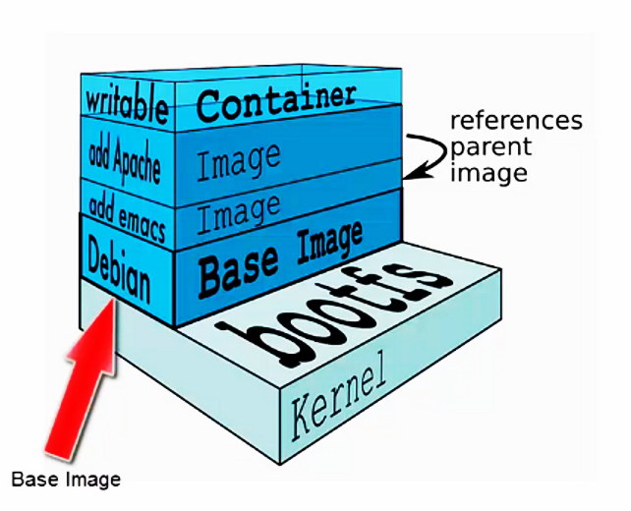
Docker Image
A Docker image is built up from a series of layers.
Base platform OS image is provided by vendors like Microsoft for Windows OS image, Canonical for Ubuntu image etc. These images get published to DockerHub.
Each layer represents an instruction in the image’s Dockerfile.
Each layer except the last one is read-only.
Notes:
A simple analogy
Perhaps a simple analogy can help getting the grasp of the core concept of Docker.
Let's go back in time to the 1950s for a moment. There were no word processors, and the photocopiers were used everywhere (kind of).
Imagine you're responsible for quickly issuing batches of letters as required, to mail them to customers, using real paper and envelopes, to be delivered physically to each customer's address (there was no email back then).
At some point, you realize the letters are just a composition of a large set of paragraphs, which are picked and arranged as needed, according to the purpose of the letter, so you devise a system to issue letters quickly, expecting to get a hefty raise.
The system is simple:
You begin with a deck of transparent sheets containing one paragraph each.
To issue a set of letters, you pick the sheets with the paragraphs you need, then you stack and align them so they look and read fine.
Finally, you place the set in the photocopier and press start to produce as many letters as required.
So, simplifying, that's the core idea of Docker.
In Docker, each layer is the resulting set of changes that happen to the filesystem after executing a command, such as, installing a program.
So, when you "look" at the filesystem after the layer has been copied, you see all the files, included the layer when the program was installed.
You can think of an image as an auxiliary read-only hard disk ready to be installed in a "computer" where the operating system is already installed.
Similarly, you can think of a container as the "computer" with the image hard disk installed. The container, just like a computer, can be powered on or off.

Slide 27
Dockerfiles
Docker builds images automatically by reading the instructions from a Dockerfile -- a text file that contains all commands, in order, needed to build a given image. A Dockerfile adheres to a specific format and set of instructions which you can find at Dockerfile reference.
A Docker image consists of read-only layers each of which represents a Dockerfile instruction. The layers are stacked and each one is a delta of the changes from the previous layer.
When you run an image and generate a container, you add a new writable layer (the “container layer”) on top of the underlying layers.
All changes made to the running container, such as writing new files, modifying existing files, and deleting files, are written to this thin writable container layer.
FROM ubuntu:18.04
COPY . /app
RUN make /app
CMD python /app/app.py
Each instruction creates one layer:
FROM creates a layer from the ubuntu:18.04 Docker image.
COPY adds files from your Docker client’s current directory.
RUN builds your application with make.
CMD specifies what command to run within the container.

Slide 28
Building Custom Images
Tim Oleson

Slide 29
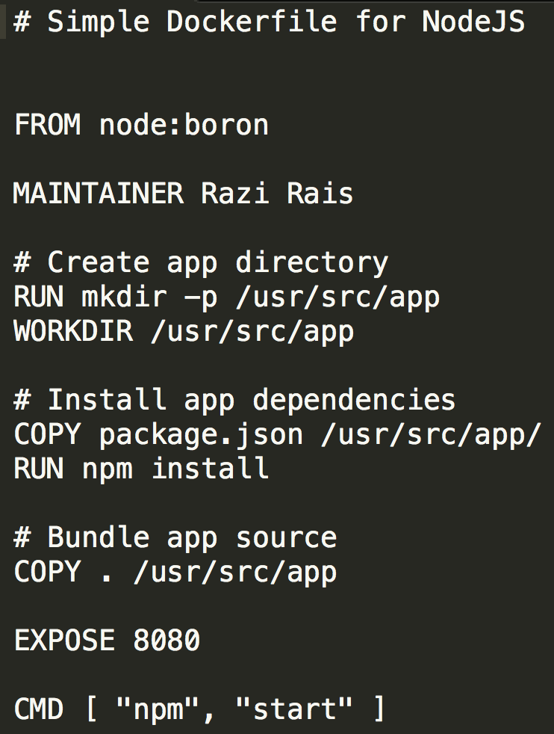
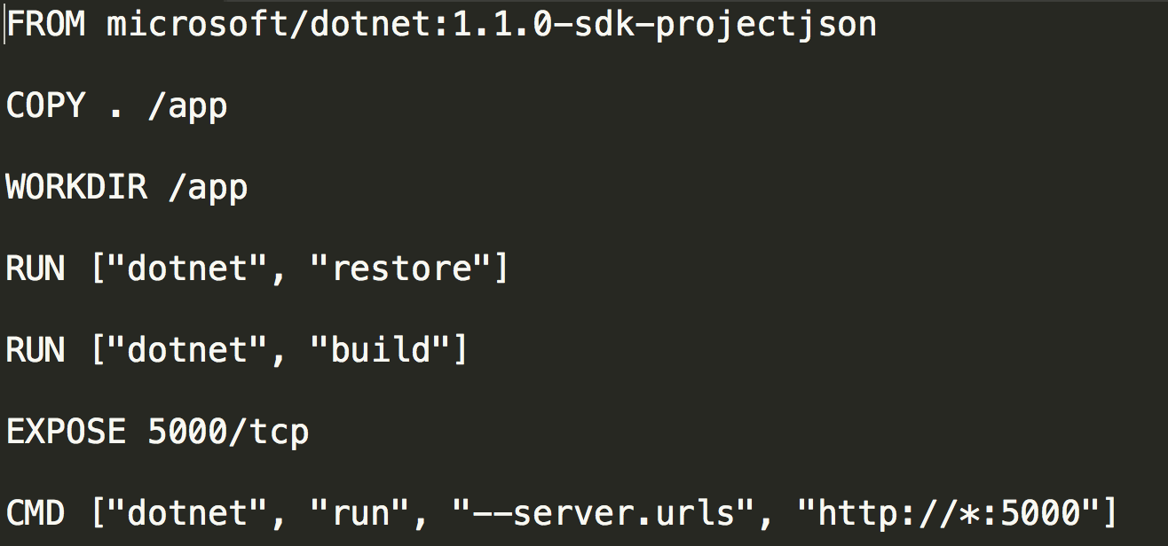
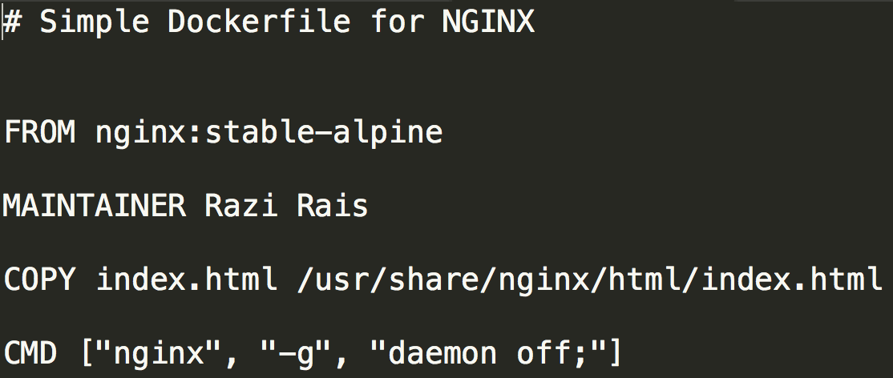
Dockerfile
Text file with Docker commands in it to create a new image. You can think of it as a configuration file with set of instructions needed to assemble a new image.
Docker has a docker build command that parses Dockerfile to build a new container image.
Notes:
Dockerfile ⬄ configuration file for container
It describes the container that can be built from it = its dependencies + how to start the container
docker build cmd=> read file and create image that can be run

Slide 30
Common Dockerfile Instructions
ADD instruction copies new files, directories or remote file URLs from <src> and adds them to the filesystem of the image at the path <dest>.
COPY instruction copies new files or directories from <src> and adds them to the filesystem of the container at the path <dest>.
CMD provide defaults for an executing container. These defaults can include an executable.
ENTRYPOINT allows you to configure a container that will run as an executable.
EXPOSE instruction informs Docker that the container listens on the specified network port(s).
FROM instruction initializes a new build stage and sets the Base Image for subsequent instructions.
LABEL is a key-value pair, stored as a string. You can specify multiple labels for an object, but each key-value pair must be unique within an object.
RUN will execute any commands in a new layer on top of the current image and commit the results.
WORKDIR instruction sets the working directory for any RUN, CMD, ENTRYPOINT, COPY and ADD instructions that follow it.
Notes:
Different instructions that can be found in Docker file
FROM: Base image or base OS used to host your system
LABEL: Key value pair to attach custom metadata to an image.
Example:
LABEL "com.example.vendor"="ACME Incorporated"
LABEL com.example.label-with-value="foo"
LABEL version="1.0"
RUN: set up commands to run when creating the container
=> example: install X, then install Y, …
WORDIR: name the directory in container where instructions will be applied
ADD and COPY: copy files to the container (Note: ADD can copy remote files as well)
CMD: Program that is going to run in the container (can be executable) (ping command)
ENTRYPOINT: Program that is going to run as an executable (dotnet yourProgram.dll)
EXPOSE: Open container port to the outside/host
https://docs.docker.com/engine/reference/builder
https://docs.docker.com/engine/reference/builder

Slide 31
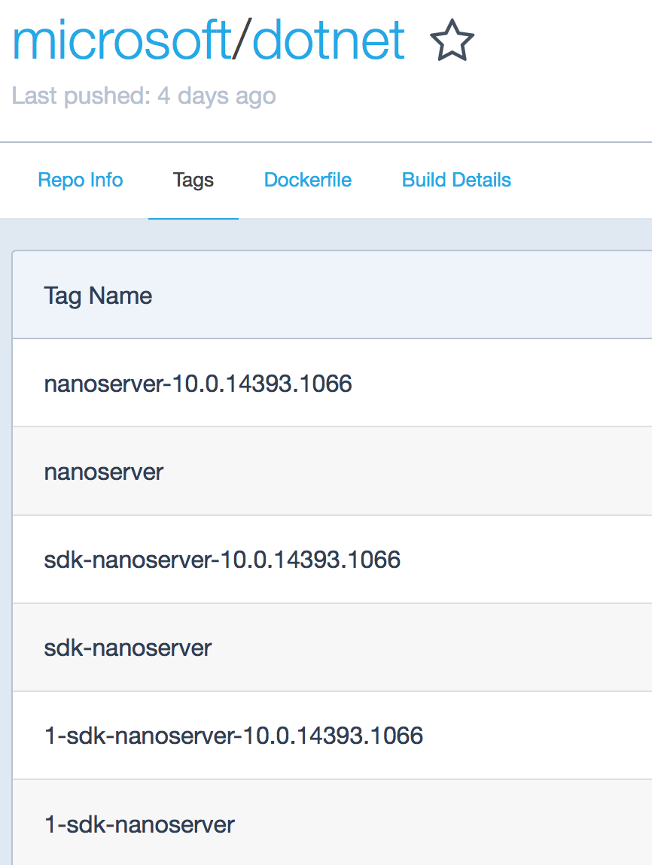
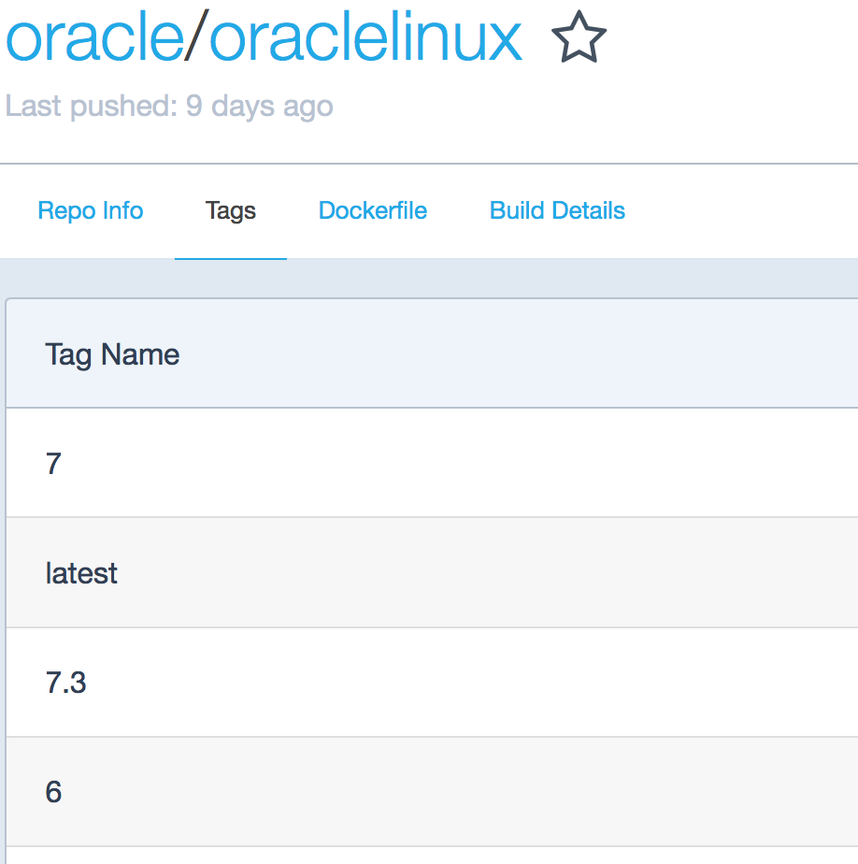
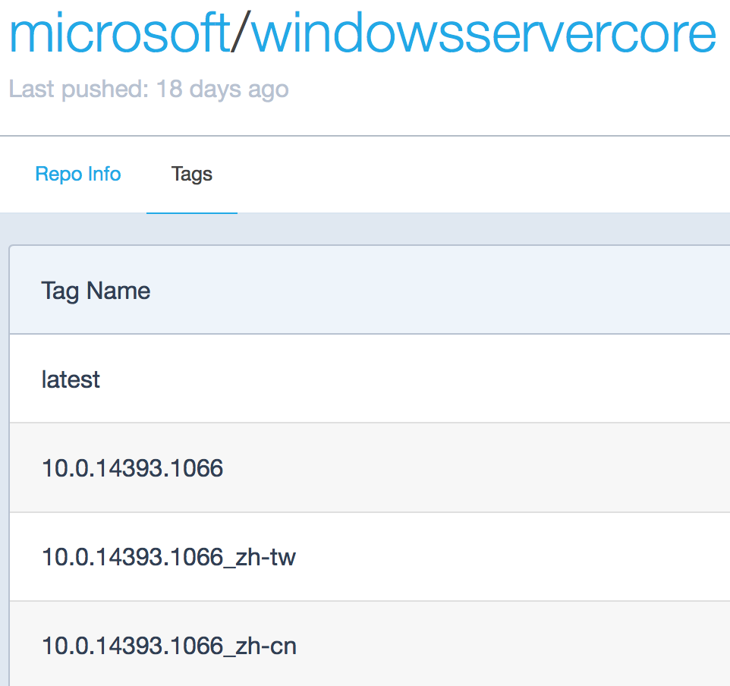
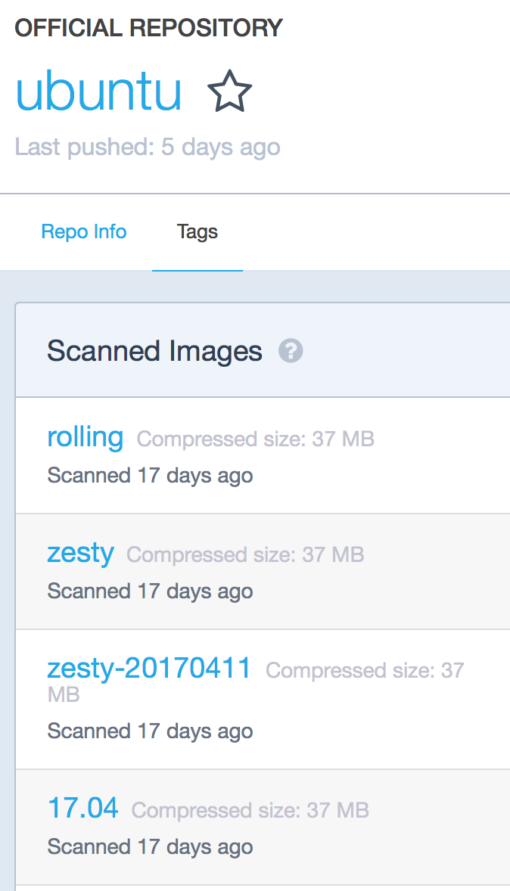
Image Tags
A Tag name is a string value that you can use to distinguish versions of your Docker images so you can preserve older copies or variants of a primary build.
You can group your images together using names and tags (if you don’t provide any tag default value of latest is assumed)
Notes:
Versioning
Opened/Flexible syntax => come up with your internal standard
Different approaches:
- Oracle => Version number
- Windows server core => locale
- Dotnet => base OS (nano server).

Slide 32
Docker Tags
docker -t gapacr.azurecr.io/aspnetapp:v1
Hub/Registry ID
Repo name
Image name

Slide 33
Docker Demo File
# https://hub.docker.com/_/microsoft-dotnet
FROM mcr.microsoft.com/dotnet/sdk:5.0 AS build
WORKDIR /source
# copy csproj and restore as distinct layers
COPY *.sln .
COPY aspnetapp/*.csproj ./aspnetapp/
RUN dotnet restore
# copy everything else and build app
COPY aspnetapp/. ./aspnetapp/
WORKDIR /source/aspnetapp
RUN dotnet publish -c release -o /app --no-restore
# final stage/image
FROM mcr.microsoft.com/dotnet/aspnet:5.0
WORKDIR /app
COPY --from=build /app ./
ENTRYPOINT ["dotnet", "aspnetapp.dll"]

Slide 34
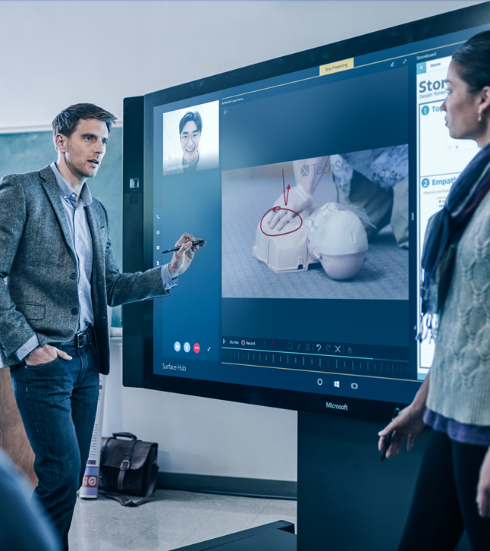
Demonstration: Dockerfile and Docker Build
Tim Oleson
Notes:
https://docs.microsoft.com/en-us/aspnet/core/host-and-deploy/docker/building-net-docker-images?view=aspnetcore-5.0
Md DockerDemo\ExampleCode
Navigate to the the folder and clone example code
C:\DockerDemo\ExampleCode>git clone https://github.com/dotnet/dotnet-docker
Navigate the app folder
cd samples/aspnetapp/aspnetapp
Run app local
dotnet-docker\samples\aspnetapp\aspnetapp>dotnet run
Navigate to Web page
https://localhost:5001/
Explain web page
Welcome to .NET
Environment
.NET 5.0.5 (X64)
Microsoft Windows 10.0.19042
Metrics
Containerized false
CPU cores 8
Memory, current usage (bytes) 64802816
Memory, max available (bytes) 1413120
Change directory
C:\DockerDemo\ExampleCode\dotnet-docker\samples\aspnetapp\aspnetapp>cd..
Tag Image local copy
docker tag aspnetapp:latest gapacr.azurecr.io/aspnetapp:v4
Push Image to ACR
Build image
\dotnet-docker\samples\aspnetapp>docker build -t aspnetapp .
Run Container
C:\DockerDemo\ExampleCode\dotnet-docker\samples\aspnetapp>docker run -it --rm -p 5000:80 --name aspnetcore_sample aspnetapp
--rm Automatically remove the container when it exits
http://localhost:5000
# https://hub.docker.com/_/microsoft-dotnet
FROM mcr.microsoft.com/dotnet/sdk:5.0 AS build
WORKDIR /source
# copy csproj and restore as distinct layers
COPY *.sln .
COPY aspnetapp/*.csproj ./aspnetapp/
RUN dotnet restore
# copy everything else and build app
COPY aspnetapp/. ./aspnetapp/
WORKDIR /source/aspnetapp
RUN dotnet publish -c release -o /app --no-restore
# final stage/image
FROM mcr.microsoft.com/dotnet/aspnet:5.0
WORKDIR /app
COPY --from=build /app ./
ENTRYPOINT ["dotnet", "aspnetapp.dll"]

Slide 35
Questions
Tim Oleson

Slide 36
Software code layout
main.js
async loadHeroes() {
this.message = 'getting the heroes, please be patient';
await this.getHeroesAction();
this.message = '';
},

Slide 37
Demo
Speaker name

Slide 38
Section title

Slide 39
Notes (hidden)
Some speakers at Microsoft like to use this slide for hidden “notes slides”.
Delete it if you don’t want to use it.
NEXT: <next slide title>

